Slide 1
The SDGs are coming to life
- Early trends, country experiences and UN Response -
Alex Warren-Rodríguez – Policy Advisor, UN DOCO
New York, October 6th 2016

Slide 2

The 2030 Agenda is underway ….
Adoption of the 2030 Agenda on September 25th 2015
SDG Global Indicator Framework endorsed by UNSC in March 2016, at its 47th session in Mexico D.F.
Global Follow Up and Review (FUR) architecture defined by UN SG
Regional Forums on Sustainable Development established in May 2016
1st HLPF of SDG era with 22 countries presenting their VNRs
Related frameworks: Paris Climate Agreement (Dec. ‘15), WHS (May ‘16)
Notes:
GLOBAL SDG INDICATOR FRAMEWORK: 17 Goals, 169 Indicators and 230 targets. Not all defined: We have Tier I, Tier II and Tier III, being managed by IAEG-SDG indicators, with Custodian agencies.
Following the request found in paragraph 90th of the 2030 Agenda, the Secretary-General, in consultation with Member States, to prepare a report for consideration at the current 70th session of the General Assembly in preparation for the 2016 meeting of the HLPF which outlines critical milestones towards coherent, efficient and inclusive follow-up and review at the global level.
22 VNR presented at the 2016 HLPF, form North and South, including: China, Colombia, Egypt, Estonia, Finland, France, Georgia, Germany, Madagascar, Mexico, Montenegro, Morocco, Norway, Philippines, Republic of Korea, Samoa, Sierra Leone, Switzerland, Togo, Turkey, Uganda, Venezuela.

Slide 3

Institutional arrangements for SDG implementation
Some countries have created new entities for SDG implementation (e.g. Bangladesh, Ghana, Colombia, Philippines)
Other countries are using existing institutional frameworks for SD (e.g. Estonia, Ethiopia, Germany)
In some countries (e.g. Norway, Uganda) SDG implementation is led by key ministry (e.g. finance)
Many countries have started engaging local authorities (e.g. Spain, Mexico, Germany, Colombia, Finland)
See DESA https://sustainabledevelopment.un.org/hlpf/2016 for more details
Notes:
Creation of new coordination entities:
• Bangladesh has established an Inter-ministerial Committee on SDG Monitoring and Implementation chaired by the Principal Secretary to the Prime Minister;
• Colombia has created a High-level Inter-ministerial Commission for the preparation and effective implementation of the post-2015 development agenda and its sustainable development goals (ODS Commission) chaired by the National Planning Department with ministerial level representation across the government;
• Ghana has established a High-Level Inter-ministerial Coordinating Committee comprised of Ministers and Directors from 11 ministries and agencies under the supervision of the President;
• The Philippines is planning to create an Inter-Ministerial Committee to be chaired by the President and led by National Economic Development Authority;
Using or adjusting existing structures:
• In Estonia, an inter-ministerial working group on sustainable development in involved in coordination of SDG implementation. The group is chaired by its Government Office, which leads SDG implementation in the country;
• Ethiopia has a National Planning Commission chaired by its Prime Minister and comprised of cabinet ministers, chief executives of regional states, among others;
• In Germany, the SDG implementation strategy is being driven by a high-level State Secretaries’ Committee for sustainable development - headed by the Chancellery with representation from all Federal ministries.
Leading Ministries
In Norway, the Ministry of Finance is currently in charge of promoting implementation, while there is an on-going discussion on the possible creation of a new inter-ministerial coordination structure;
• In Uganda, the Ministry of Finance, Planning and Economic Development is leading the way.
Involving local authorities
Spain: The Basque and Catalan regional governments are drafting SDG implementation strategies
Finland is open for new participatory arrangements as needed, so as to reach out to sub-national government levels and to ordinary citizens;
Germany is establishing engagement through organised local government organizations;

Slide 4

… there is also active engagement of parliaments
In Uganda, Parliament played a critical role in leading national Post-2015 consultations
In Norway, Government will follow up on SDGs through annual budget process and will present relevant documents for Parliamentary approval
The Finnish Parliament’s Development Policy Committee is tasked to follow up on SDG implementation
An SDG Task Force has been established in the National Assembly of Pakistan
The Parliament of Trinidad and Tobago has established a new Joint Select Committee on Environment and Sustainable Development.

Slide 5
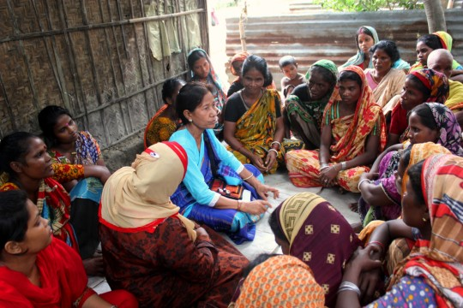
Mechanisms for CSO and private sector engagement
Egypt is making multi-stakeholder involvement central to SDG M&E based on open data platforms incorporating stakeholder participation to generate data on SDGs trends.
In Estonia, the Commission for SD acts as a stakeholder forum and performs advisory functions in the implementation and monitoring of the SDGs.
In Germany, the Council for SD advises the government on sustainability policy. It comprises 15individuals from business, trade unions and other stakeholders appointed by the Chancellor.
Mexico will create a multi-stakeholder initiative to facilitate access to data and enhance collaboration on the SDGs.
The Netherlands has a established the “Global Goals Charter NL” stakeholder coalition. Participants have signed the charter and are contributing to SDG implementation

Slide 6

Countries in complex situations are often leading the way
Sierra Leone has mainstreamed all of its SDGs into its national budget and is planning to create an Inter-Ministerial Committee which will include as its members, the President, Finance Minister and other line ministers
Somalia will align its NDP to the SDGs and establish a multi-stakeholder National Development Council.
The DRC will integrate the SDGs into its 2017-2021 NDP, will establish a national SDG working group and is developing a roadmap for SDG implementation.

Slide 7

Work is underway to establish SDG M&E frameworks
In Bangladesh, the monitoring and auditing of SDG indicators are distributed across the full range of ministries and agencies;
In the Czech Republic and Uganda, NSOs have established new SDG data coordination platforms in government
In Madagascar, the Ministry of Economy and the NSO have updated the National Strategy for the Development of Statistics, to provide an M&E framework for SDG targets;
Switzerland will use its sustainable development monitoring system (MONET), which includes 75 regularly updated indicators, to measure and report on the SDGs.
Turkmenistan is localizing SDG indicators and creating an M&E system with a phased and inclusive approach

Slide 8
UNCTs providing support to national
SDG response
100 of 131 UNCTs (76.3%) responded “Yes” to question: “Has your government requested support on their national response to Sustainable Development Goals?”
*There are six UNCTs in HICs which report in the IMS (Argentina, Bahrain, Kuwait, Saudi Arabia, Seychelles and United Arab Emirates)

Slide 9
Orientation, Mainstreaming, Measurement and Reporting as support to the national SDG response
100
68
69
50
14

Slide 10
UNCT direct support to national planning 2015-16
78 UNCTs responded “Yes” to the question: “Did the UN support the development of the National Plan?”

Slide 11
116 of 131 UNCTs support national statistical capacities in 2016
122 of 131 UNCTs responded to question: “Does the UNCT provide support to national statistical capacity?” and 116 said ‘yes’

Slide 12


Slide 13
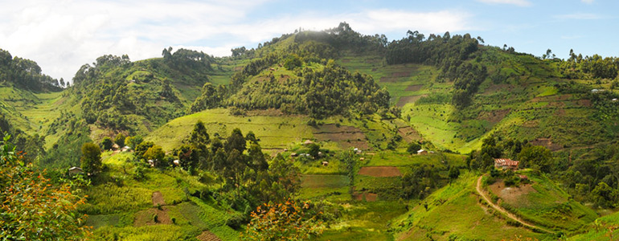
Uganda
Post-2015 consultations coincided and were aligned with national Vision 2040. As a result, 76% of SDG targets are mainstreamed in the NDP-II
More than 80% of targets have been mainstreamed UNDAF (2016-2020)
UNCT is already implementing 5 of 8 MAPS mainstreaming areas:
  Domestication of the proceeding of the Addis conference
  Training of local government planning experts and media on mainstreaming SDGs
  Translation of materials for SDG popularization into four major languages.
  Appointment of SDG ambassadors to popularize the goals (Museveni SDG16)
  Partnership with local SDG ambassadors to popularize SDGs through short animation video - Popularization of SDGs on Television
  “Anthem-mainstreaming”: Use of the national anthem to popularize the SDGs

Slide 14

Turkmenistan
In Oct. 2015, the UNCT advocated with government to adopt a 3 stage process to roll out the SDGs. This was approved at the highest level.
Stage 1: Conduct national consultations with key sector ministries to agree on the adoption of the universal 17 SDG goals and 169 targets and 200 plus indicators that are relevant to Turkmenistan
Stage 2: Integrate SDGs, targets & indicators into the 5 year Presidential Programme for 2017-2021 and targeted sectoral plans and strategies
Stage 3: Define data systems required to measure progress for targeted SDGs in selected line ministries and National State Statistics Committee

Slide 15
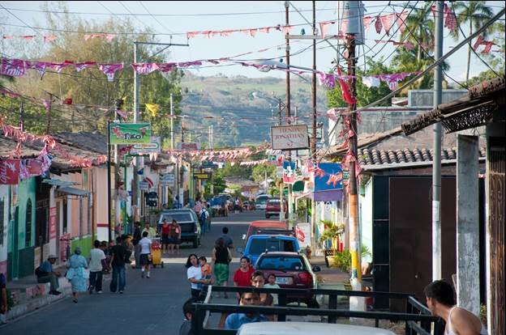
El Salvador
Framework for long term cooperation between the UNCT and the Government to implement the 2030 Agenda signed in late 2015
The content of this MoU follows the interagency guidance established for MAPS, and includes a role for the UN in supporting the Government in planning, monitoring and reporting.
It foresees the establishment National Council for Sustainable Development to be created by Presidential Decree.
All state institutions will be trained on the SDGs, already kick-started in the health sector with over 80 directors and Minister of Health
The UN will deliver as One on SDG 16 in relation to the national security plan

Slide 16

LAO PDR
In November 2015 the PM committed to mainstream SDGs in Laos’ 8th NDP
SDG consultation meetings co-chaired by the UN RC and Government led to the inclusion of additional SDG goal 18: ‘Lives safe from UXO’
Lao PDR will be monitoring the means of implementation
Through UNDG mainstreaming support, a gap analysis is being conducted (baselines, data and systems to measure progress towards the SDGs)
The UN is also supporting government in conducting SDG localization in north of the country, to inform the provincial government and provincial level planning
“Namkan2013: Picturing the Global Goals”, an initiative by the UNCG: students invited to share photographs how they view Laos in 15 years.

Slide 17


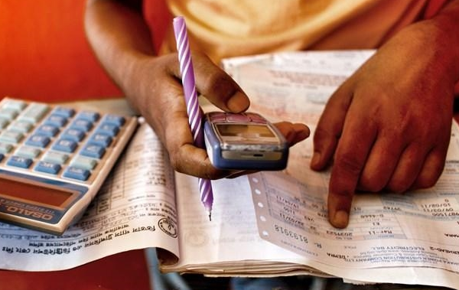
The MAPS Common Approach
MAINSTREAMING
ACCELERATION
POLICY SUPPORT
Landing SDGs at national and local levels: integration into national and sub-national plans for development; and into budget allocations
Will need to be linked to the new UNDAF Guidelines
Focus on priority areas defined by countries
Support an integrated approach, including synergies and trade-offs
Bottlenecks assessment, financing and partnerships, and measurement
Support – skills and experience - from respective UN agencies to countries, which should be made available at a low cost in a timely manner
Notes:
MAPS was adopted by the UNDG in October 2015 as a common approach to its support to the SDGs at the country level
It responds to Member States’ request for coherent and integrated support to the SDGs
It captures the core components of the UNDG’s upstream support to the SDGs: Mainstreaming, Acceleration, Policy Support
Work under the MAPS Common Approach should be guided by the following principles:
Must be demand driven and tailored to country-specific needs;
Complement and build on existing capacities and resources in the UNDS
Encourage working together, using integrated approaches, so as to deliver together for higher impact

Slide 18
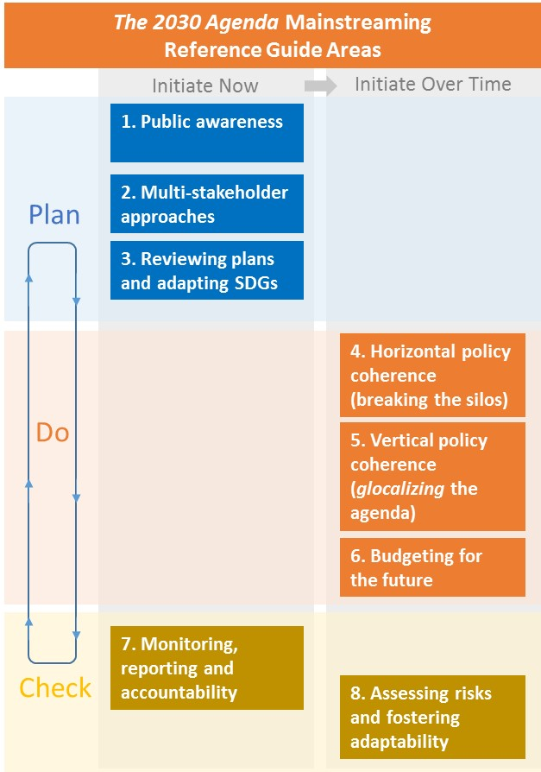
The MAPS Mainstreaming Reference Guide
Provides an array of approaches and tools that UNCTs can discuss with Member States to help land and adapt the Agenda to national, sub-national and local conditions and realities.
A menu of options, with case studies providing examples of how some countries have begun to develop and use relevant tools.
It might also be of direct use to a broader audience of government officials and development practitioners.
Available in English, French and Spanish, soon to be put on UNDG online platform and updated with new resources
Been developed into training material by UNDP, UN Staff College and UNITAR

Slide 19
Acceleration component of MAPS
Work underway to develop a Acceleration toolkit – Planned for end Q1-2017:
Living and evolving ‘menu’ of tools, composed of existing and new tools that help identify accelerators of change
Practical in nature to assist national development planning and policymaking and cater to a range of country realities, skills and capacity
To include: diagnostics guidelines, econometric models, foresight, scenario-building and back-casting, programming methodologies, etc.
To be organized around an initial set of topics:
  Integration: multi-sectoral and cross-cutting solutions, whole-of-Gov. approaches
  Last-mile analysis – to help ‘leave no one behind’
  Risk-informed development planning to tackle vulnerability, uncertainty and shocks

Slide 20
Joint Fund for Integrated Policy Support
Concept note for a Joint Fund for IPS in the process of approval by UNDG:
Builds on experience of DRT Fund (but open to all countries)
Focus on IPS interventions that contribute to integrated, multi-dimension and whole-of-government approaches to policy making
Embedded in UNDAF cycle set-up to strengthen DaO approaches
Longer funding-cycles to encourage innovation and deeper engagement in policy cycle
Strengthen HQ fund support to program design and implementation
Partnership approach

Slide 21
UNDG Guidelines for country-led national SDG reports
These guidelines seek to provide guidance to UNCTs and MS on how to conduct national review processes through national SDG reports that:
  Go beyond monitoring: encouraging analytical SDG reporting
Promote inclusive national policy dialogue
Promote mutual accountability
Facilitate comparability
Build collaboration for policy coherence in government
Encourage a coordinating role of NSOs
Build on UN experience with MDG reports (500+ national MDG reports)
Ideally will contribute strengthen national SDG review exercises, a core foundation of the SDG Follow Up and Review (FUR) process.

Slide 22
The new UNDAF Guidelines
  Focus on integrated approaches to programming in support of SDGs
  Mandatory CCA and link to 15 year SDG objectives through Vision 2030+ exercise
  New set of programming principles:
  Human rights, gender equality and women’s empowerment
  Sustainable development and resilience
  ‘Leave no one behind’
  Accountability (underpinned by national capacities, robust data and RBM)
  Underpinned by risk management, a focus on data, partnerships, systems-thinking policy coherence and cross-charter integration as enablers to Integrated programming
  Interim guidelines launched in May. Guidelines currently under revision to take stock of feedback from UNDAF rollout UNCTs and develop ‘companion guidelines’

Slide 23
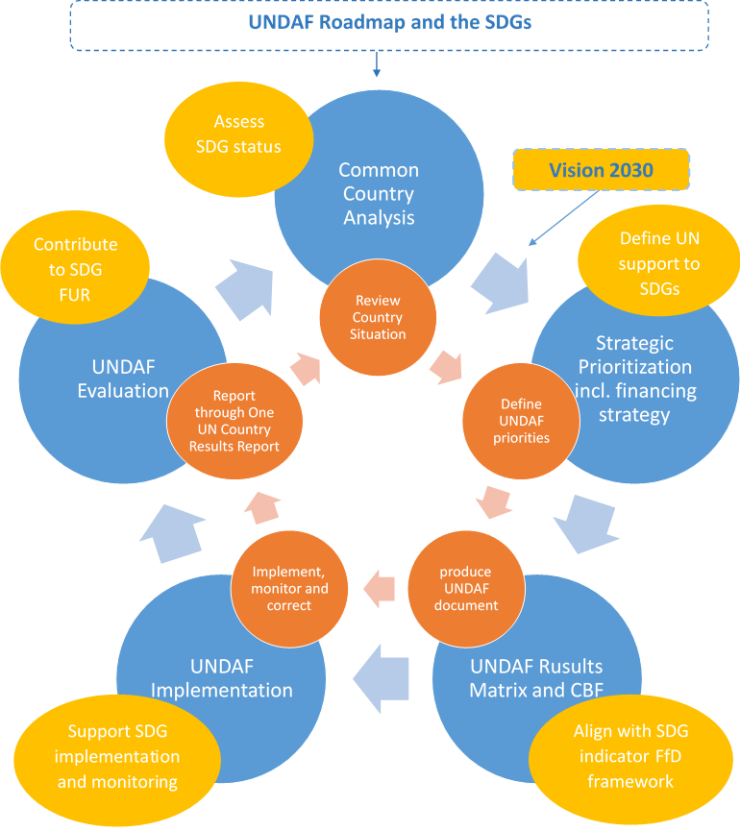

Slide 24
Additional resources:
‘SDGs are coming to life’ – Website
‘SDGs are coming to life’ – Publication
SG’s report on FUR process – here
New interim UNDAF Guidelines – Here
MAPS Mainstreaming reference guide – here
2016 HLPF – here
DESA’s institutional arrangements for SDGs – here
www.deliver2030.org

